Slide 1
Quiz Prep Session - Week 12
Recursion and Tree

Slide 2
EMP Session
11/12 - Recursion and Tree
https://cs199emp.netlify.app/dist/2020-11-12.html
11/17 - Recursion and Tree p2
https://cs199emp.netlify.app/dist/2020-11-17.html

Slide 3
Recursion
Return some value
Base case e.g. foo(0)
Main process
foo(10)
foo(int i)
Not base case
Recursion:
e.g. foo(i-1)

Slide 4
Recursion - isPalindrome (String in)
Input 1: “acbbca”
true
true
true
true
isPalindrome(“acbbca”)
isPalindrome(“cbbc”)
isPalindrome(“bb”)
isPalindrome(“”)
# check the characters on both ends of the string.
> “a” = “a” -> true, look at substring:
> “acbbca” -> “cbbc”
> “c” = “c” -> true, look at substring:
> “cbbc” -> “bb”
> “b” = “b” -> true, look at substring:
> “bb” -> “” # empty string
Input string length <= 1,
So this is a base case:
Return true
Input 2: “cbac”
false
false
isPalindrome(“cbac”)
isPalindrome(“ba”)
> “c” = “c” -> true, look at substring:
> “cbac” -> “ba”
> “b” != “a” -> return false

Slide 5
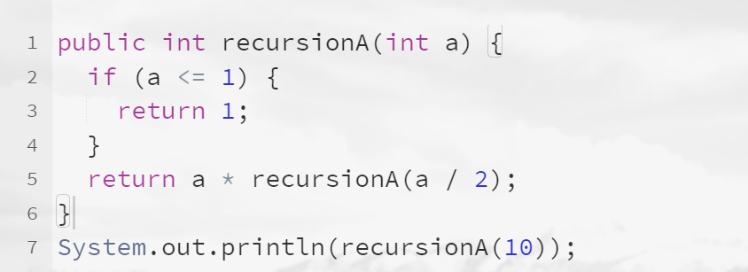
Recursion - Practices
Practice 1.a
How many recursion calls are made in the following codes (including the initial call)?
Notes:
10 -> 5 -> 2 -> 1 => 4 calls

Slide 6
Recursion - Practices
Practice 1.b
What will be printed out?
Notes:
10 -> 5 -> 2 -> 1 => 4 calls

Slide 7
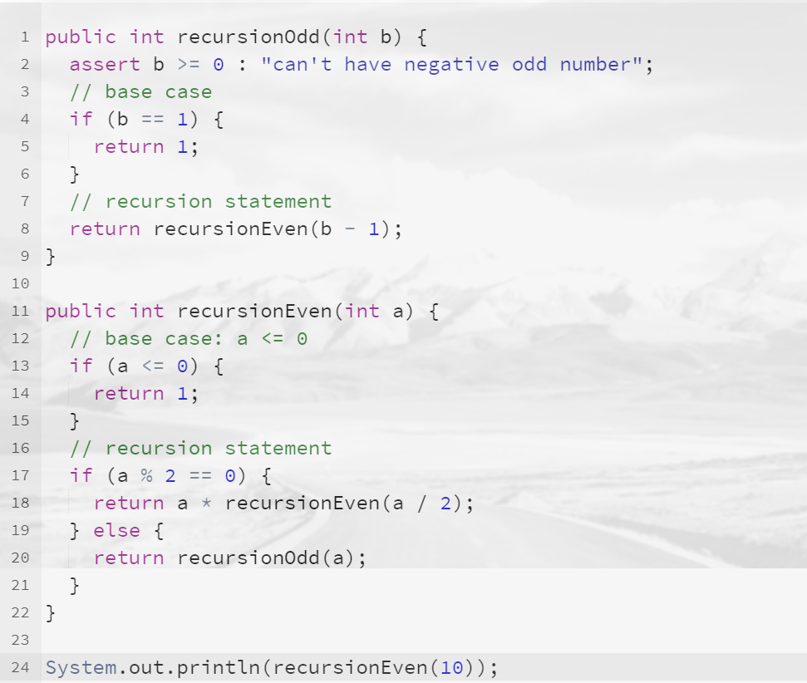
Recursion - Practices
A little bit harder!
Practice 1 - Special Edition
How many times are recursionEven() called?
How many times are recursiveOdd() called?
What will be printed out?
Notes:
10 -> 5 -> 2 -> 1 => 4 calls

Slide 8
Trees
root
Depth h = 0
Value = 15
Left child
Right
child
A binary tree structure
Value = 8
Value = 23
h = 1
h = 2
...

Slide 9
Trees
Important aspects regarding a BinaryTree with N nodes and H depths:
(Tree size) If each depth h in the tree is totally filled, what is the size N of the tree represented by H?
(Binary Search Tree) Assume all left child nodes have smaller values than their parents, and all right child nodes have larger values than their parents, what is the average runtime for searching for a value in the tree?
Value = 15
Value = 8
Value = 23

Slide 10
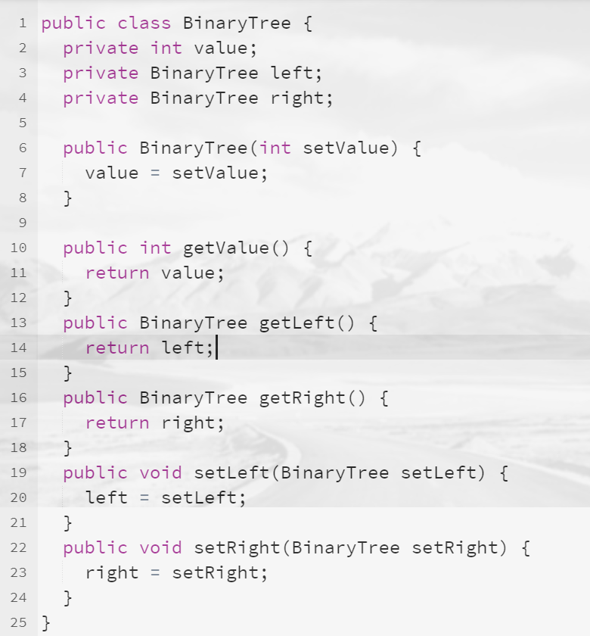
Trees - Practices
Given the following definition of a BinaryTree class:
Write a method to search for a certain value from the root. If the value exists in the tree (any node), return true, otherwise return false. We also have the following assumptions:
Left child nodes have smaller values than their parents;
Right child nodes have larger values than their parents.

Slide 11
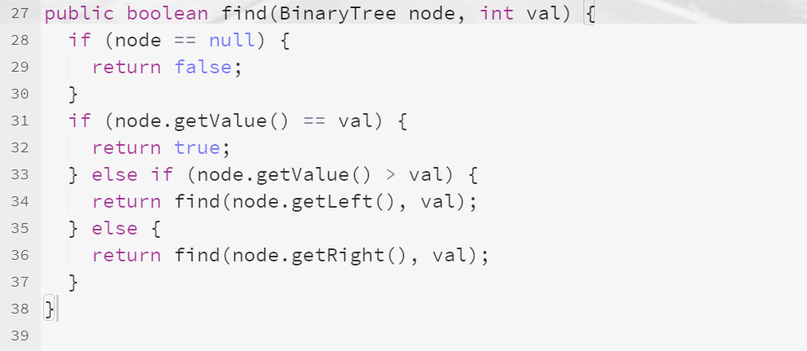
Trees - Practice Solution

